Slide 1
Melvin the Marvellous Monster from Mars
From the Brains Of:
  Kevin Scroggins
  Stephany Lay
  Julie Powers

Slide 2
Overview
Concept
Game Flow / Objectives
Game Layout
Fun Elements and Features :D
Summary
Q&A

Slide 3
Introduction
Concept
  You are an alien that has crash-landed on Earth.
Objectives
  The game will take you through your experiences trying to understand/discover Earth and live amongst its inhabitants.

Slide 4
Introduction
Perspective
  2D Side-Scrolling Platformer
  Multiple areas
Flow
  You will perform various quests to ultimately reach an end goal, such as repairing your ship. (Non-linear game flow)

Slide 5
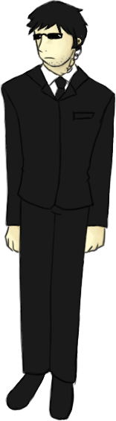






Concept Art

Slide 6
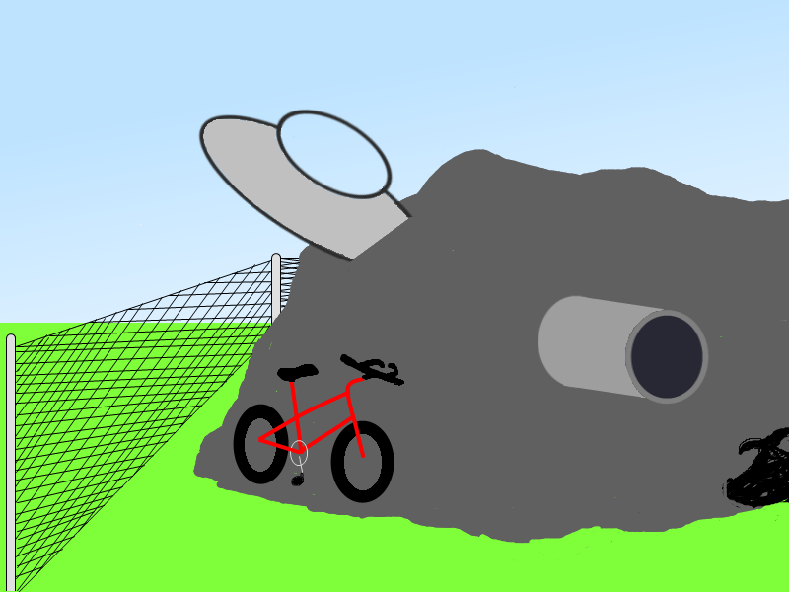
Layout

Slide 7
Features
Collectable items (randomized)
  Shopping
  Able to combine / interact with
Choose between multiple quests
  Result in alternate endings
Interact with other life forms
Optional pet alien
Disguises
Central hiding place

Slide 8
Summary
Alien on Earth (Crash-landed)
2D-Sidescroller
Able to interact with items, lifeforms and the environment
Dynamic gameplay (non-linear)

